Slide 1
Class Exercise
The production manager wants to compare the average weights of popcorns from two production lines. Experience shows that the weights of popcorns can be assumed to be normal. He would like to know whether the true mean of the weights of popcorns from two production lines are different than each other. He obtained the following data:
Note that the corresponding degrees of freedom is 25 for Case 3.
 | Distribution of the weights | Sample size (n₁, n₂) | True standard deviation known/unknown ((σ₁, σ₂)/ (s₁, s₂))
1 | Normal | (12, 16) | (σ₁, σ₂) = (0.5, 0.6)
2 | Unknown | (12, 16) | (s₁, s₂) = (0.5, 0.6)
3 | Normal | (12, 16) | (s₁, s₂) = (0.5, 0.6)
4 | Unknown | (42, 46) | (s₁, s₂) = (0.5, 0.6)
Popcorn-poll.xlsx
Notes:
-

Slide 2
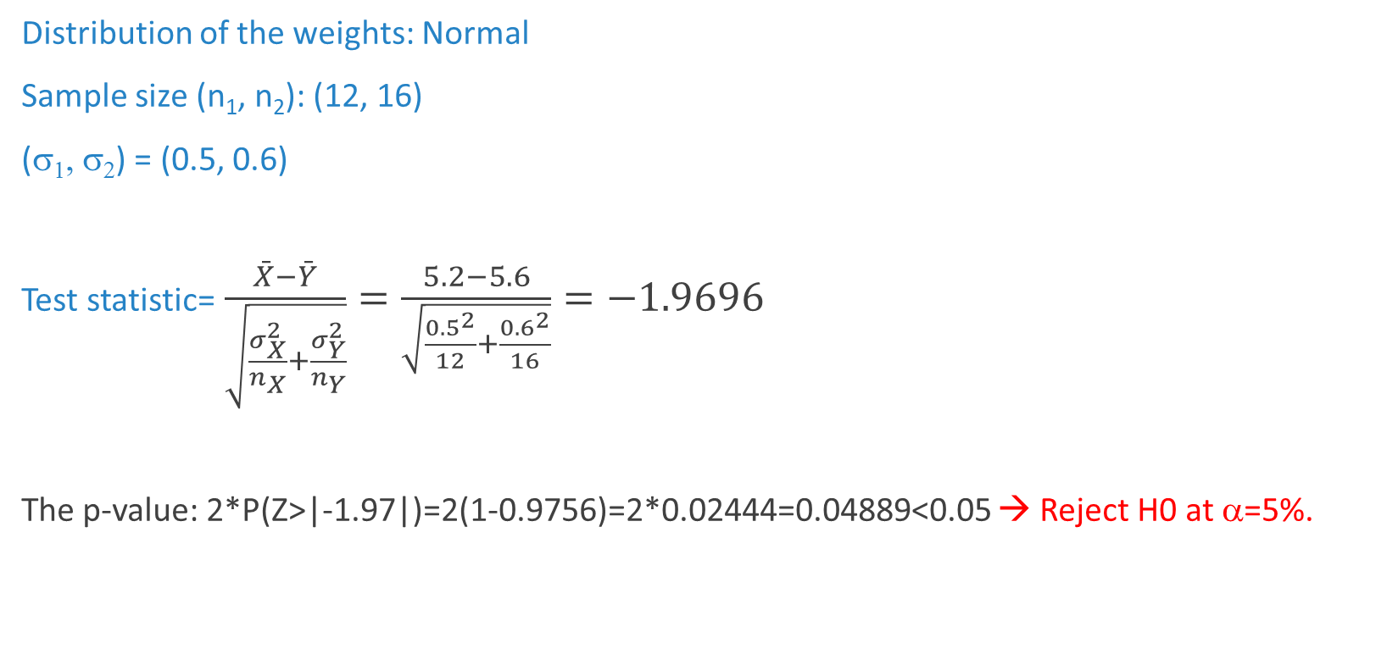
Class Exercise – (1)
Distribution of the weights: Normal
Sample size (n₁, n₂): (12, 16)
(σ₁, σ₂) = (0.5, 0.6)
Test statistic=$\frac{\bar{X}−\bar{Y}}{\sqrt{\frac{σ_{X}^{2}}{n_{X}}+\frac{σ_{Y}^{2}}{n_{Y}}}}=\frac{5.2−5.6}{\sqrt{\frac{{0.5}^{2}}{12}+\frac{{0.6}^{2}}{16}}}=−1.9696$
The p-value: 2*P(Z>|-1.97|)=2(1-0.9756)=2*0.02444=0.04889<0.05 → Reject H0 at α=5%.
→ Cannot reject H0 at α=1%.
Notes:
-

Slide 3
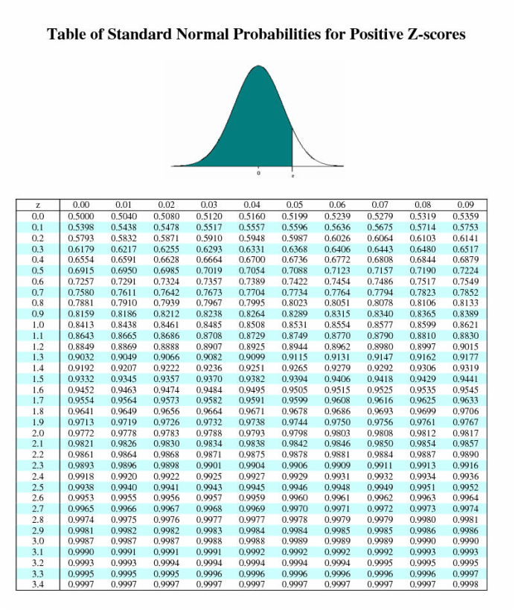

Slide 4
Class Exercise – (2)
Distribution of the weights: Unknown
Sample size (n₁, n₂): (12, 16)
(s₁, s₂) = (0.5, 0.6)
Cannot carry out the test since we do not know the distribution of the test statistic.
Notes:
-

Slide 5
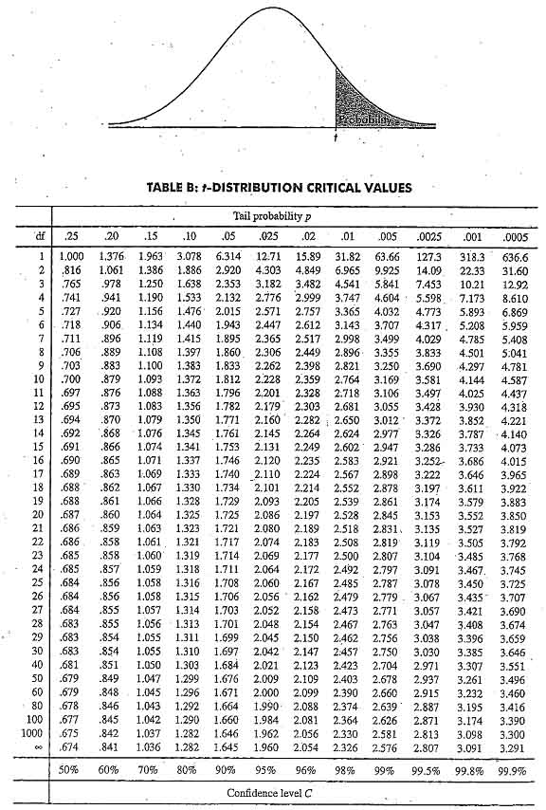
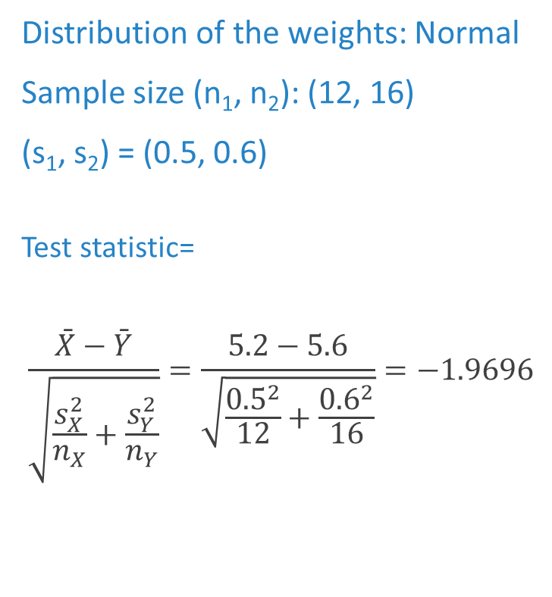
Class Exercise – (3)
Distribution of the weights: Normal
Sample size (n₁, n₂): (12, 16)
(s₁, s₂) = (0.5, 0.6)
Test statistic=
$$\frac{\bar{X}−\bar{Y}}{\sqrt{\frac{s_{X}^{2}}{n_{X}}+\frac{s_{Y}^{2}}{n_{Y}}}}=\frac{5.2−5.6}{\sqrt{\frac{{0.5}^{2}}{12}+\frac{{0.6}^{2}}{16}}}=−1.9696$$
Notes:
-

Slide 6
Class Exercise – (3)
Distribution of the weights: Normal
Sample size (n₁, n₂): (12, 16)
(s₁, s₂) = (0.5, 0.6)
The degrees of freedom is 25.
Test statistic=-1.9696
1.708<1.9696<2.060
2*0.025 < p value < 2*0.05
0.05 < p value < 0.10
Cannot reject H0 at α=5%.
Reject H0 at α=10%.
Notes:
-

Slide 7
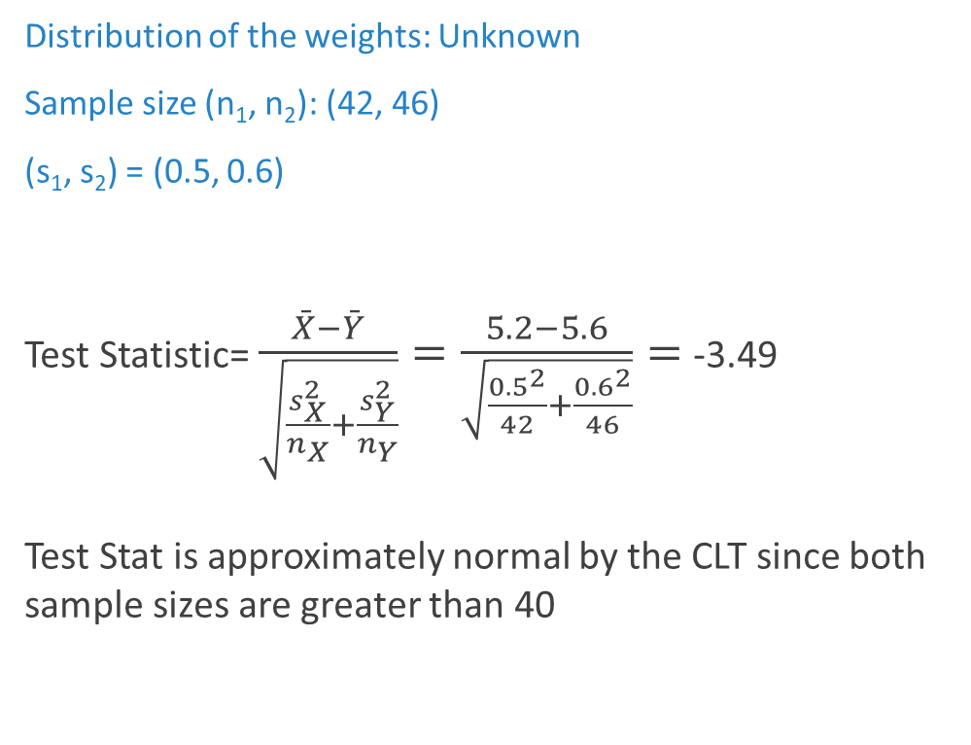
Class Exercise – (4)
Distribution of the weights: Unknown
Sample size (n₁, n₂): (42, 46)
(s₁, s₂) = (0.5, 0.6)
Test Statistic= $\frac{\bar{X}−\bar{Y}}{\sqrt{\frac{s_{X}^{2}}{n_{X}}+\frac{s_{Y}^{2}}{n_{Y}}}}=\frac{5.2−5.6}{\sqrt{\frac{{0.5}^{2}}{42}+\frac{{0.6}^{2}}{46}}}=$-3.49
Test Stat is approximately normal by the CLT since both sample sizes are greater than 40
The p-value:
2*P(Z>| -3.49 |)=2(1-0.9998)=2*0.0002=0.0004,
which is smaller than all plausible significance levels
→ Reject H0 at α=1%.
Notes:
-

